Slide 1


Geetha Shishu Shikshana Sangha ®
GSSS
INSTITUTE OF ENGINEERING &
TECHNOLOGY FOR WOMEN
K R S Road, Metagalli, Mysuru – 570016, Karnataka State
(Affiliated to VTU, Belagavi, Approved by AICTE, New Delhi & Govt. of Karnataka)
Accredited by NAAC
DEPARTMENT OF COMPUTER SCIENCE AND ENGINEERING
Accredited by NBA, New Delhi, (Validity: 01.07.2023– 30.06.2026)
Project Work Phase II – Review 1
“HireGenAI – AI Powered Hiring Intelligence Platform”
By Batch 6
Chandana B C [4GW23CS020]
Manya V [4GW23CS058]
Megha B M [4GW23CS060] Samiksha [4GW23CS094]
Under the Guidance of Co-Guide
Nausheen Shamsi and Hampana S R Dr.Rajath A N
Assistant Professors Associate Professor
Dept.of CSE Dept.of AI&DS

Slide 2


CONTENTS
Introduction
Literature survey
Scope of project/ Problem statement
Aim and Objectives
Methodology
Hardware & Software Requirements
Architecture of the System
Design diagrams
Expected Outcome
Project Timeline
References

Slide 3

INTRODUCTION
Recruitment is one of the most important and time-consuming processes in organizations.
Traditional hiring methods involve manual resume screening, skill matching, and interview preparation, which require significant human effort and may lead to biased or inefficient decisions.
HireGenAI is an AI-powered hiring intelligence platform developed using LangGraph, and Groq LLM.
The system automates resume parsing, job description analysis, candidate scoring, and interview question generation.
By using AI agents and structured workflows, the platform improves recruitment efficiency, accuracy, and decision-making while reducing manual effort

Slide 4
LITERATURE SURVEY
Title of the Paper | Author Details and Published Year | Technique used | Shortcomings
AI-Driven Resume Parsing and Recruitment System using NLP and Generative AI | Abisha D,Keerthana S.Kavitha K,Ramya r,2024 | Generative AI for recruitment | High API cost and slower response
AI-Powered Applicant Tracking System: An Intelligent Approach to Modern Recruitment | Ashutosh Kumar, Veenit Kumar, Alok , Raushan Kumar, Ankush Paswan,2025 | Intelligent applicant tracking system | No AI-generated candidate summaries
AutoScreen-FW: An LLM-based Framework for Resume Screening | Zhelin Xu, Shuhei Yamamoto, Atsuyuki Morishima,2026 | LLM framework for resume screening | Requires high cloud resources
Smart-Hiring: An Explainable End-to-End Pipeline for CV Information Extraction and Job Matching | Kenza Khelkhal, Dihia Lanasri, 2025 | NLP Pipeline, Named Entity Recognition, Contextual Embeddings | Limited real-time recruiter interaction and dashboard visualization

Slide 5
LITERATURE SURVEY
Title of the Paper | Author Details and Published Year | Technique used | Shortcomings
AI Hiring with LLMs: A Context-Aware and Explainable Multi-Agent Framework for Resume Screening | Frank P.-W. Lo, Jianing Qiu, Zeyu Wang, Haibao Yu, Yeming Chen, Gao Zhang, Benny Lo, 2025 | Multi-agent LLM-based resume screening | High computational complexity and less user interaction
Application of LLM Agents in Recruitment: A Novel Framework for Resume Screening | Chengguang Gan, Qinghao Zhang, Tatsunori Mori,2024 | LLM agents for recruitment automation | Limited personalized interview generation
Resume Screening With Natural Language Processing (NLP) | Mehtap Saatçı et al., 2024 | NLP-based resume parsing | Keyword-based matching gives lower accuracy

Slide 6
LITERATURE SURVEY
Title of the Paper | Author Details and Published Year | Technique used | Shortcomings
Resume Data Extract and Job Recruitment Chatbot Features for AI-Based Resume Screening & Analytics | Kar Weng Chong, Kok Why Ng , Yong Hong Fu,20 | AI Recruitment Chatbot, NLP, LLM | Focuses mainly on chatbot interaction
Resume Screening using Machine Learning | Dr. Sandeep Tayal et al., 2024 (Maharaja Agrasen Institute of Technology, Delhi) | Machine Learning, NLP, SVM, KNN | Traditional ML models fail to understand contextual meaning in resumes
Explainable AI in Employment Decision-Making: A Systematic Review of Transparency Methods in Hiring Algorithms | Stephen Fabeyo, 2025 | Explainable AI (XAI), Hiring Algorithms, Transparency Methods | Existing systems lack user-friendly implementation and dynamic candidate insights

Slide 7
PROBLEM STATEMENT
Manual resume screening consumes significant time and resources.
Recruiters face difficulty in matching candidate skills with job requirements accurately.
Traditional hiring processes may introduce human bias and inconsistency.
Generating personalized interview questions manually is difficult and time-consuming.
Existing recruitment systems lack intelligent candidate analysis and ranking mechanisms.

Slide 8
AIM & OBJECTIVES
Aim:
To develop an AI-based hiring intelligence platform that automates resume screening, candidate ranking, and interview question generation using Large Language Models and multi-agent architecture.
Objective:
To automate resume parsing and candidate information extraction.
To analyze job descriptions and identify required skills and experience.
To rank candidates using AI-based scoring techniques.
To generate personalized interview questions for shortlisted candidates.

Slide 9
METHODOLOGY
Upload resumes and job description through Streamlit interface
Extract resume text from PDF/TXT files
Resume Parser Agent extracts candidate details using Groq LLM
JD Analyzer Agent identifies required skills and experience
Matching Agent compares resume with job requirements
Calculate candidate matching and ranking scores
Generate AI-based candidate summaries and strengths
Display ranked candidates in the dashboard

Slide 10
HARDWARE & SOFTWARE REQUIREMENTS
  Software Requirements :
  Python
  LangChain
  LangGraph
  Pydantic
  API-Groq API
Hardware Requirements:
Intel i5 Processor or above
Minimum 8 GB RAM
Stable Internet Connection

Slide 11
EXPECTED OUTCOME
Automated resume screening system.
Accurate candidate ranking based on job requirements.
AI-generated interview questions for candidates.
Reduced recruitment time and manual effort.
Improved hiring efficiency and decision-making.

Slide 12
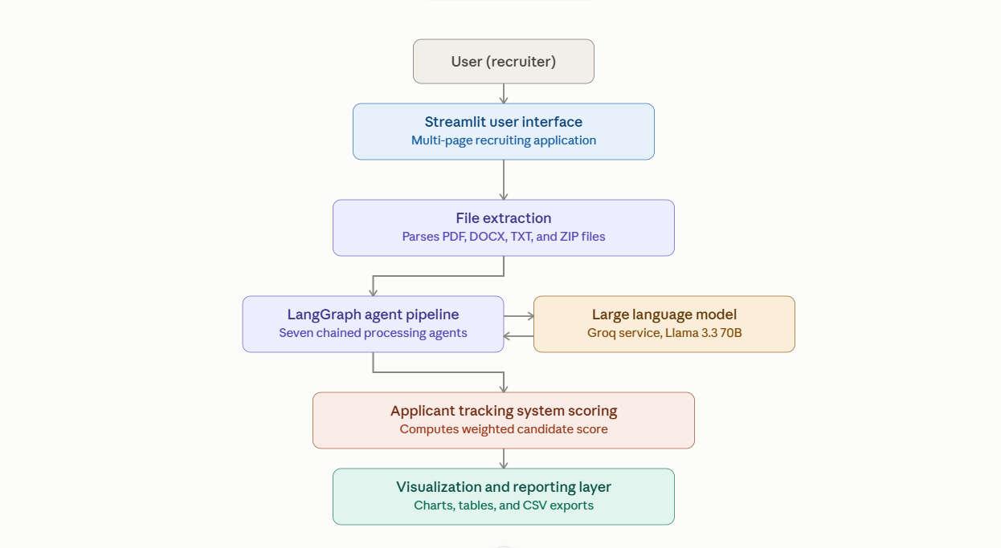
ARCHITECTURE OF THE SYSTEM

Slide 13
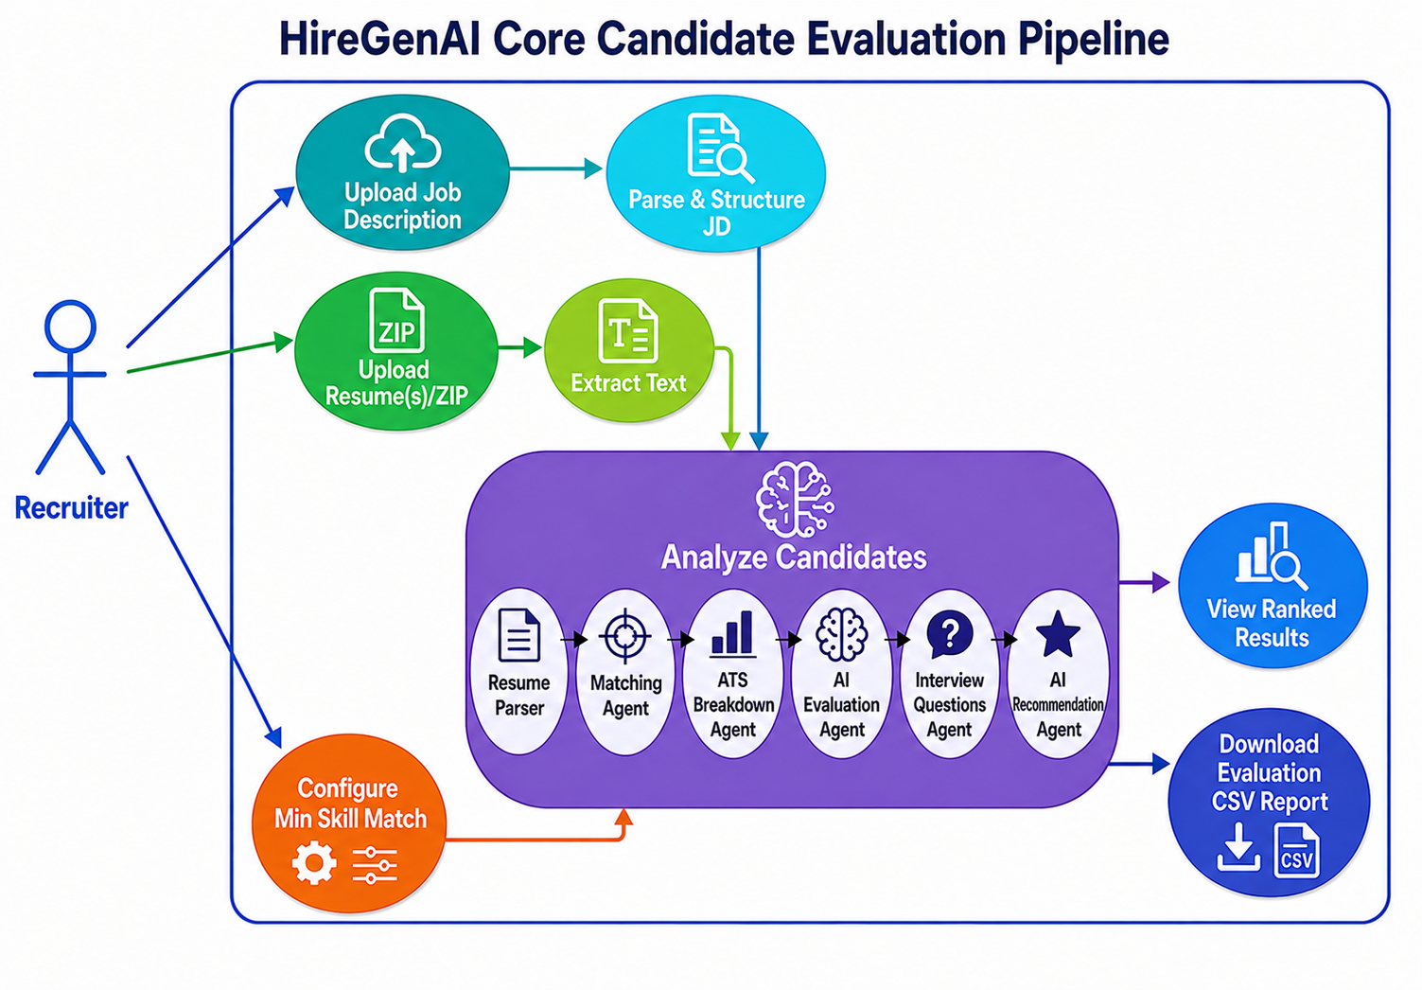
USE CASE DIAGRAM

Slide 14
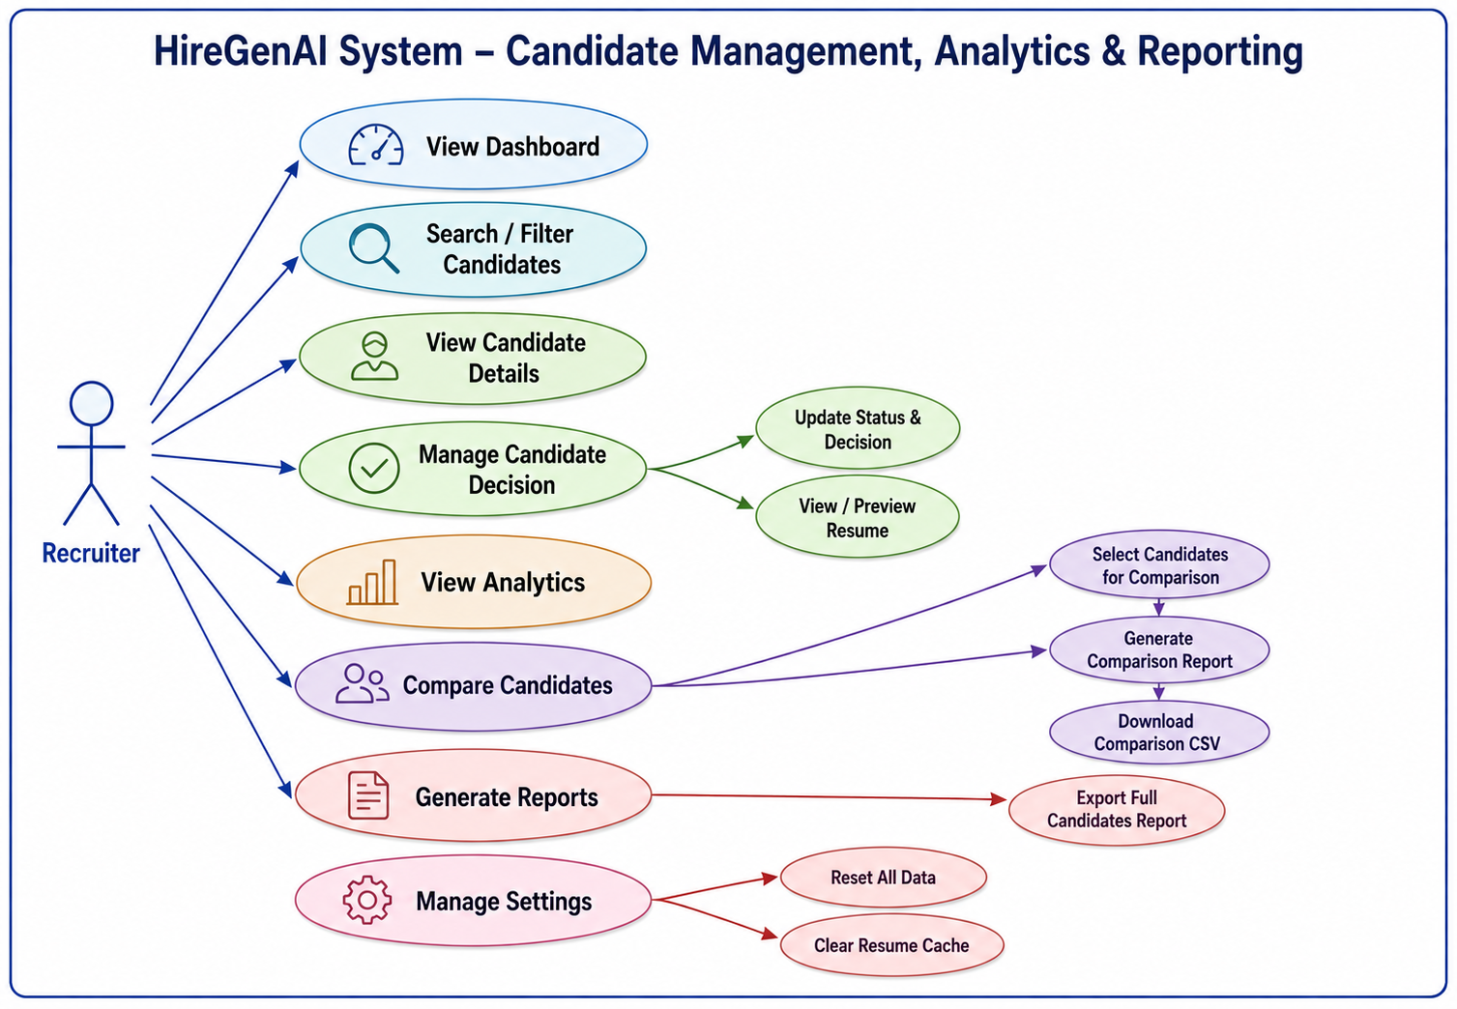
USE CASE DIAGRAM

Slide 15
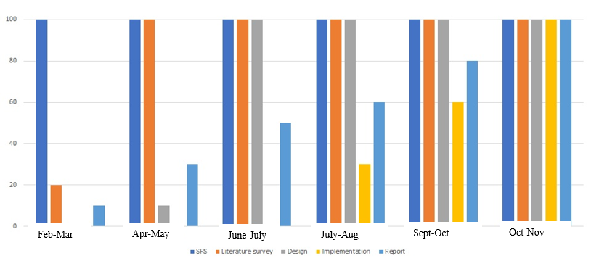
PROJECT TIMELINE

Slide 16

REFERENCES
Frank P. W. Lo et al., “AI Hiring with LLMs: A Context-Aware and Explainable Multi-Agent Framework for Resume Screening,” arXiv, 2025. Available: https://arxiv.org/abs/2504.02870
“Application of LLM Agents in Recruitment: A Novel Framework for Resume Screening,” arXiv, 2024. Available: https://arxiv.org/abs/2401.08315
Mehtap Saatçı et al., “Resume Screening With Natural Language Processing (NLP),” ResearchGate, 2024. Available: https://www.researchgate.net/publication/387588598

Slide 17
Queries?

Slide 18
Thank You

